Slide 1
Automation Testing
Regression Testing
Incremental development and continuous integration project
Frequent running tests are required

Slide 2
Selenium
Selenium is a web Automation tool which can used to perform testing ONLY on Web Applications not Desktop based applications.
There are others tool which can be used to automate both web applications and windows applications like QTP (Quick Test Professional) . As every one aware that QTP is Licensed Tool AND Selenium is Open source tool, download it configure it and enjoy.
Selenium Webdriver: It makes direct calls to the browser using each browser's native support for automation. Webdriver was developed to better support dynamic web pages like Ajax where elements of a page may change without the page itself being reloaded.

Slide 3
Locators for Selenium
id Select element with the specified @id attribute.
Name Select first element with the specified @name attribute.
Linktext Select link (anchor tag) element which contains text matching the specified link text
Partial Linktext Select link (anchor tag) element which contains text matching the specified partial link text
Tag Name Locate Element using a Tag Name .
Class name Locate Element using a class Name ..
Css Select the element using css selectors. You can check here for Css examples and You can also refer W3C CSS Locatros
Xpath Locate an element using an XPath expression.

Slide 4
TestNG
TestNG is a unit test framework designed for testing needs (developers / Test Engineers). It is inspired from JUnit by adding new functionalities which made TestNG more powerful than other unit test frameworks.
We can use TestNG for the below reasons: 1. To Run test cases in the order which we provide 2. We can run classes without using Main method. 3. To generate reports 4. We can Parameterize Tests 5. Group tests and execute only specific group 6. Implement logging using TestNG Listeners
7. Integrate with ANT

Slide 5
Page Object(1)
Selenium Page Factory Pattern is like an extension to Page Object Model , but Page Factory is much enhanced model. To start with, we just need to import package ‘org.openqa.selenium.support.PageFactory’
"Factory class can be used to make using Page Objects simpler and easier".
We use Page Factory pattern to initialize web elements which are defined in Page Objects.

Slide 6
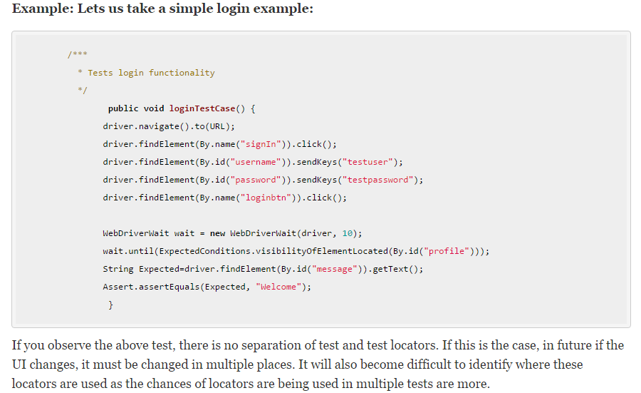
Page Object(2)

Slide 7
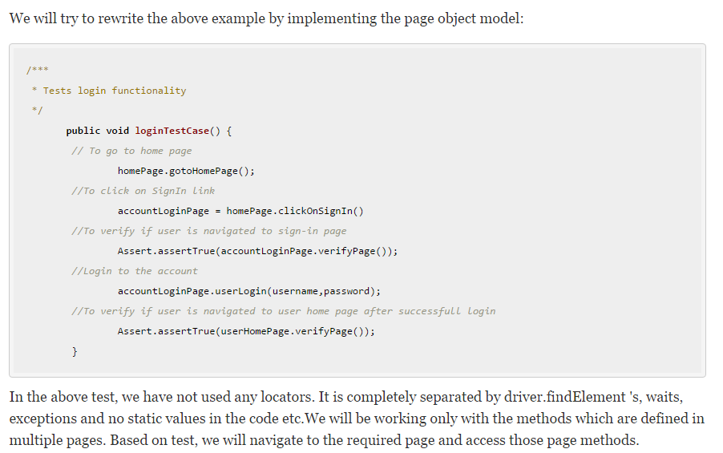
Page Object(3)

